Slide 1
Academic Approval
Tracking System
Casey T. Griffith
Assistant Director of Curriculum and Academic Policy Office of Undergraduate Affairs

Slide 2
Creating New Courses Request

Slide 3
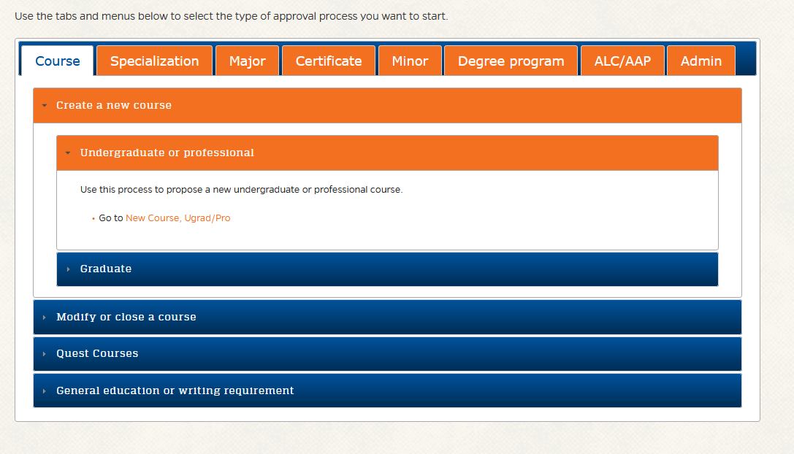
New Course Requests
Where to Start:
Using the Approval System to submit New Course Requests
https://approval.ufl.edu/start-new-request/

Slide 4
New Course Requests
The Process
Process Steps
The academic approval tracking system will automatically route the request (including all accompanying forms and documents) to the following groups for approval and/or notification.
Department (Approval is required from the Chair or other designated approver for the department that will offer the course, typically following review by the department curriculum committee.)
College (Approval is required from the Dean or other designated approver for the college or unit in the preceding step, typically following review by the college curriculum committee.)
UCC (Approval is required from the University Curriculum Committee.)
SCNS (Approval is required from the Florida Board of Education, with inclusion of the course in the Statewide Course Numbering System.)
OUR (The Office of the University Registrar implements any approved changes into the student systems, including the catalog.)
SASS (The change will be entered into the Student Academic Support System, effective in the term approved for the request.)
CAT (A final verification is done to ensure that all approved changes were properly entered into the undergraduate catalog, effective in the term approved for the request.)
College [N] (The College is notified of request approval.)
*3. PCC (Approval is required from the Professional Curriculum Committee)
*Majority of these steps are set and will not change. Steps 3 & 7 may have possible changes in the future with the creation of the PCC.

Slide 5
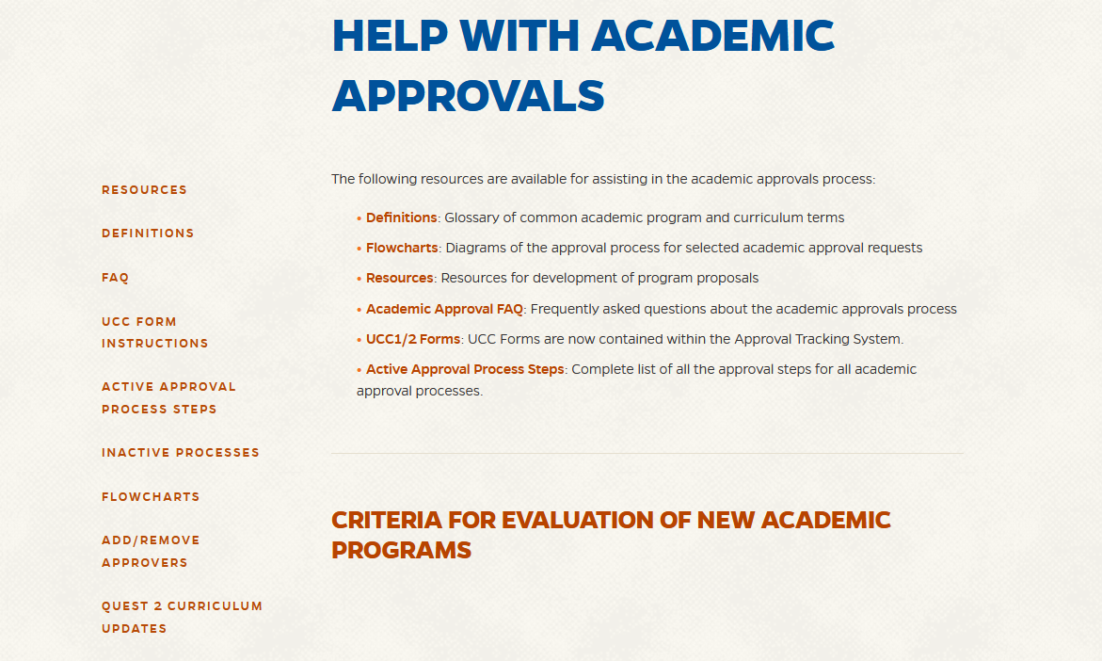
New Course Requests
Help
https://approval.ufl.edu/help/
OR email cgriffith@aa.ufl.edu

Slide 6
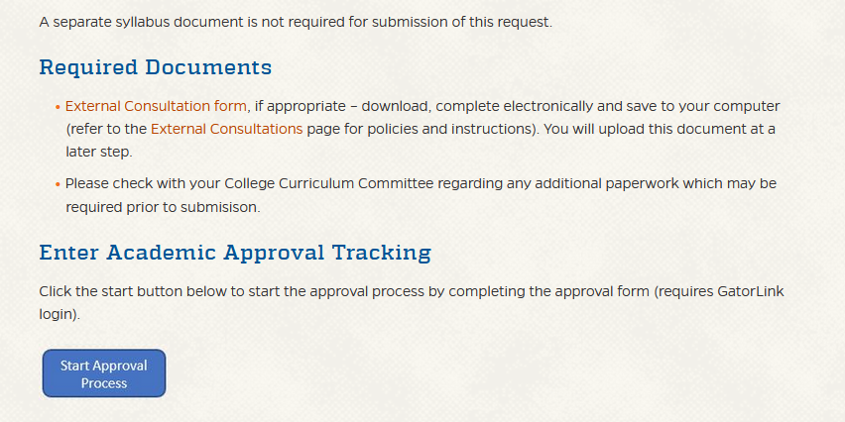
New Course Requests
Creating the Request/What to Include
https://approval.ufl.edu/start-new-request/

Slide 7
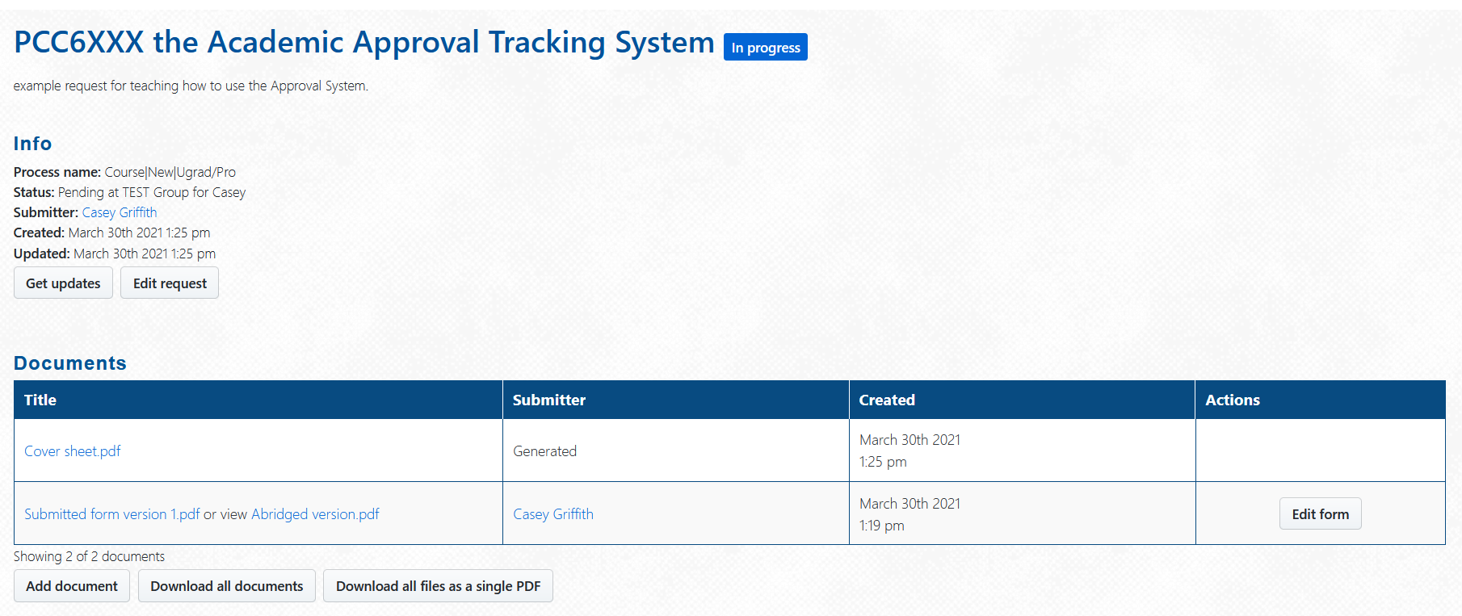
New Course Requests
The Form
https://secure.aa.ufl.edu/Approval/reports/16043

Slide 8
New Course Requests
Submission page

Slide 9
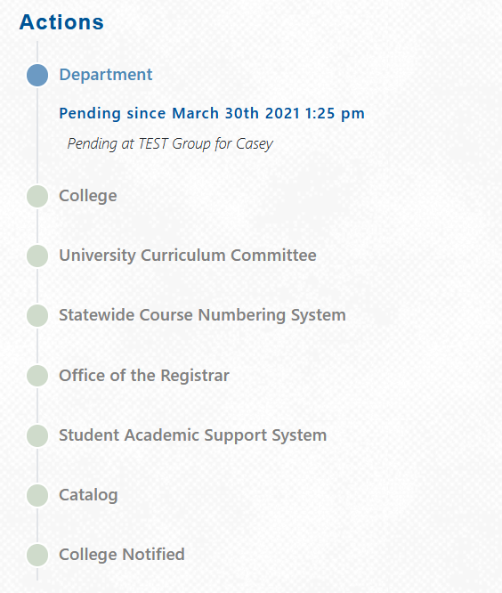
New Course Requests
Actions/Tracking
Every action/comment will be recorded here (below the main information section of each specific request.

Slide 10
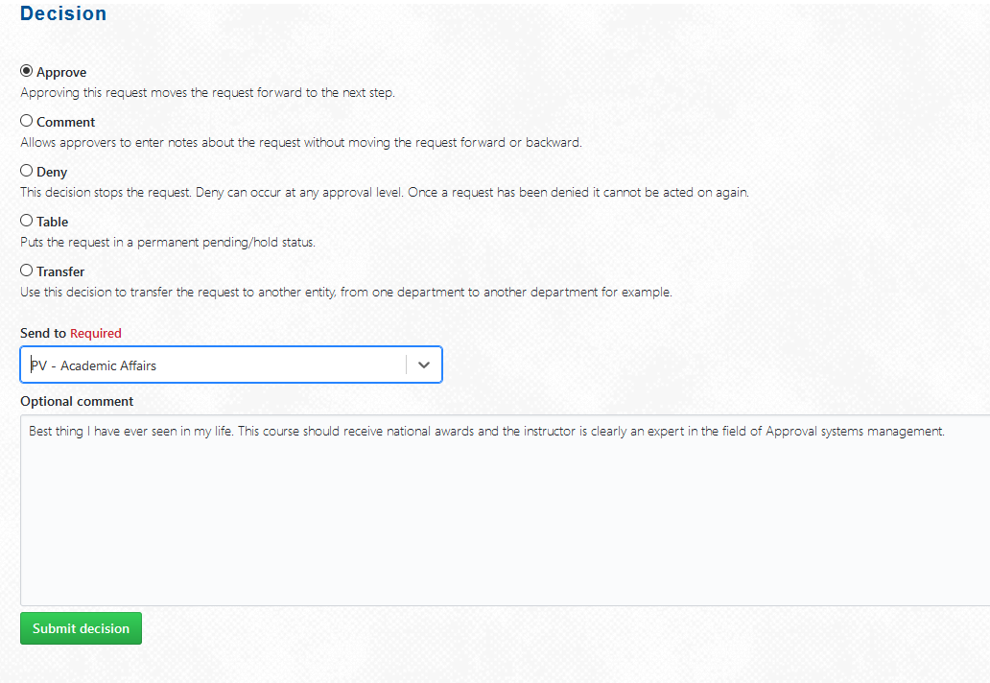
New Course Requests
Entering Actions
https://secure.aa.ufl.edu/Approval/reports/16043

Slide 11
New Course Requests
Assistance/Questions
Help
https://approval.ufl.edu/help/
Policies
https://approval.ufl.edu/policies/
Reports
https://approval.ufl.edu/reports/
https://secure.aa.ufl.edu/Approval/reports/16043

